Slide 1
Samsung Innovation Campus

Slide 2
SMART GST – Intelligent GST Billing & Fraud
Detection System
Team Members:
G.Veshal​, S.Likitha, Sruthi Jadhav, Y.Kavya Reddy, V.Vijayalakshmi

Slide 3
INTRODUCTION
SMART GST – Intelligent GST Billing & Fraud
Detection System
​
MEDLEAF AN AI BASED SYSTEM
SMART GST is a web-based intelligent billing system designed to automate GST calculation, invoice generation, and fraud detection.
It simplifies billing by providing accurate GST insights through smart logic, voice input, and instant PDF invoices.
The system ensures transparency and prevents overcharging, making GST billing faster, reliable, and user-friendly.

Slide 4
TEAM CONTRIBUTION
SMART GST – Intelligent GST Billing & Fraud
Detection System
G.Veshal – Designed and managed the project database.
S.Likitha – Developed the backend logic and APIs.
Sruthi Jadhav – Built the user interface for SmartGST.
Y.Kavya Reddy – Tested the application for accuracy and bugs.
V.Vijayalakshmi – Created and organized the project presentation.

Slide 5
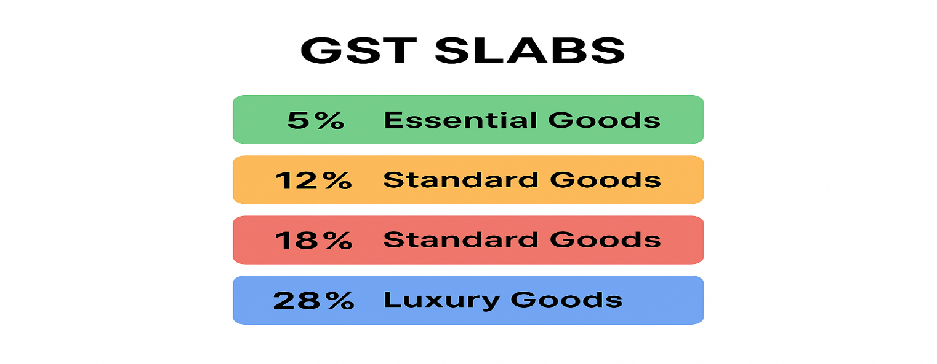
PROBLEM STATEMENT​
SMART GST – Intelligent GST Billing & Fraud
Detection System
Consumers often struggle to correctly calculate GST, verify billing accuracy, and detect overcharging by shops. Existing tools lack voice input, fraud detection, and automated invoice generation. SmartGST solves this by providing a simple, smart, and accurate GST calculator with built-in fraud detection and billing history

Slide 6
​Existing System
SMART GST – Intelligent GST Billing & Fraud
Detection System
Users manually calculate GST or rely on basic calculators that only apply standard percentages.
Most tools do not support voice input, inclusive/exclusive GST modes, or dynamic GST category selection.
There is no fraud detection, so users cannot verify if shops overcharged them.
Billing history and auto-generated invoices are typically not available in existing GST calculators.
​

Slide 7
PROPOSED SYSTEM
SMART GST – Intelligent GST Billing & Fraud
Detection System
The proposed SmartGST system provides an automated and accurate GST calculation platform with both inclusive and exclusive modes.
It eliminates manual errors by using a smart backend engine for GST slab detection and category selection.
A fraud detection module ensures customers are not overcharged by comparing billed and actual GST totals.
The system also supports voice input, billing history storage, and automatic invoice generation.
Overall, SmartGST delivers a fast, reliable, and user-friendly solution for transparent GST billing.

Slide 8
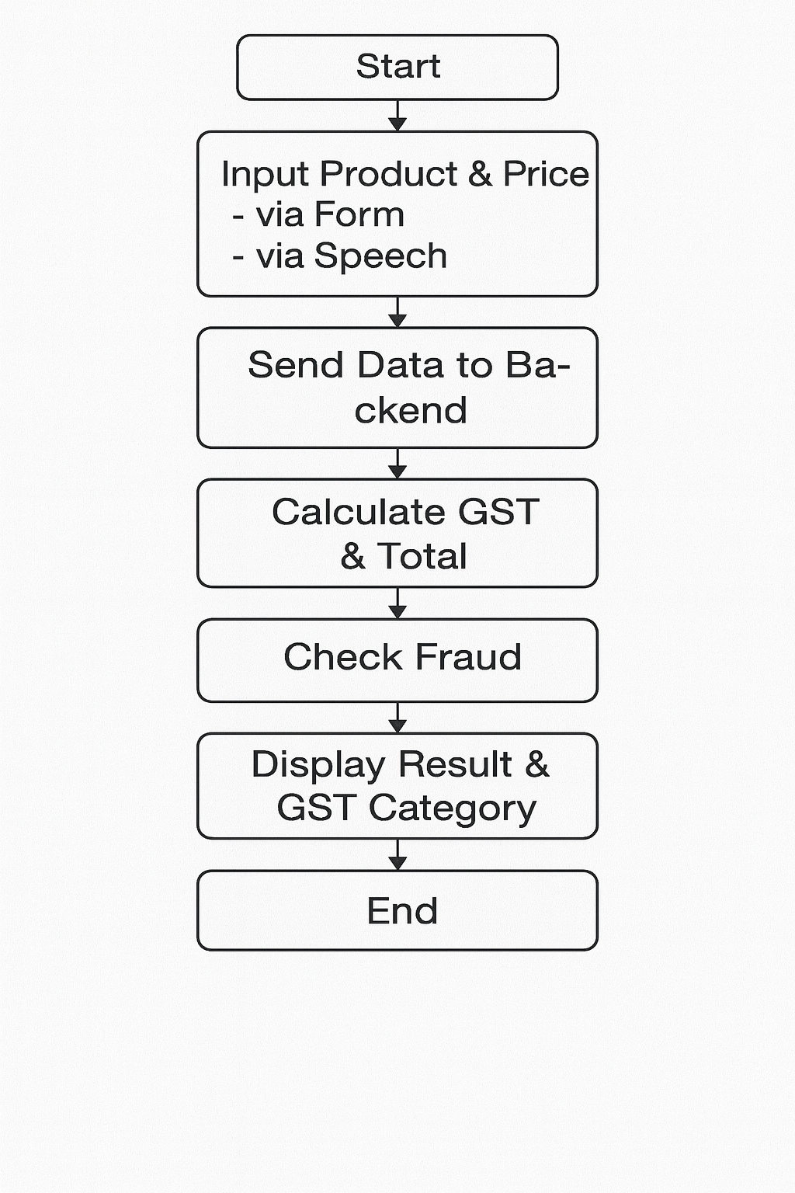
WORKFLOW
SMART GST – Intelligent GST Billing & Fraud
Detection System

Slide 9
Objective/Goals : To provide a fast and accurate GST calculation system for users. To prevent customer overcharging using an automated fraud detection module. To simplify billing with voice input, invoice generation, and easy history tracking. To make GST billing transparent, user-friendly, and error-free. To build a lightweight, efficient system using Flask APIs and a clean web UI.
SMART GST – Intelligent GST Billing & Fraud
Detection System

Slide 10
SMART GST – Intelligent GST Billing & Fraud
Detection System
Modules/Key Features: 1.GST Calculation Module
Calculates GST using slabs with exclusive/inclusive modes and category selection (CGST/SGST/IGST).
2. Voice Input Module
Allows users to speak product and price, extracting numbers intelligently (e.g., 20k, 2 lakh).
3. Fraud Detection Module
Checks if the shop has overcharged by comparing billed amount with system-calculated total.
4. History Management Module
Stores previous GST calculations and displays billing history to users.

Slide 11
Modules:
SMART GST – Intelligent GST Billing & Fraud
Detection System
.
5. Invoice Generation Module
Creates downloadable PDF invoices based on the user's GST calculation.
6. Backend API Module (Flask)
Handles all server-side operations like calculation, fraud detection, history, and invoice via REST APIs.
7. Frontend UI Module
User-friendly interface with input fields, buttons, history panel, results, and voice integration.

Slide 12
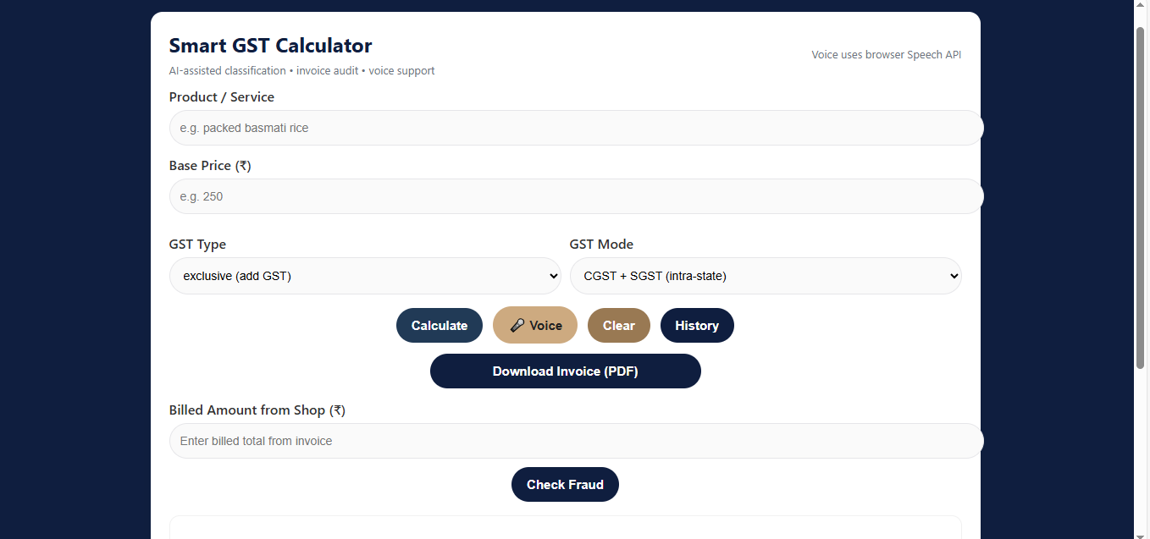
Results
SMART GST – Intelligent GST Billing & Fraud
Detection System
.
.

Slide 13
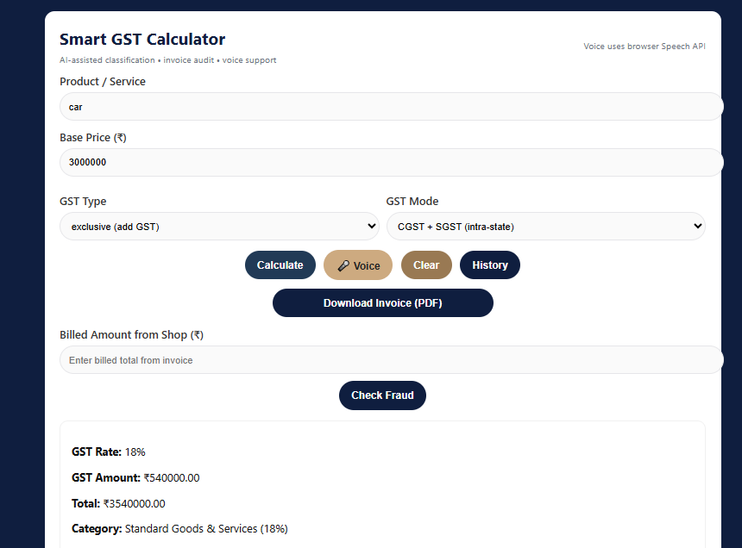
SMART GST – Intelligent GST Billing & Fraud
Detection System
.
SMART GST – Intelligent GST Billing & Fraud
Detection System
GST Calculation

Slide 14
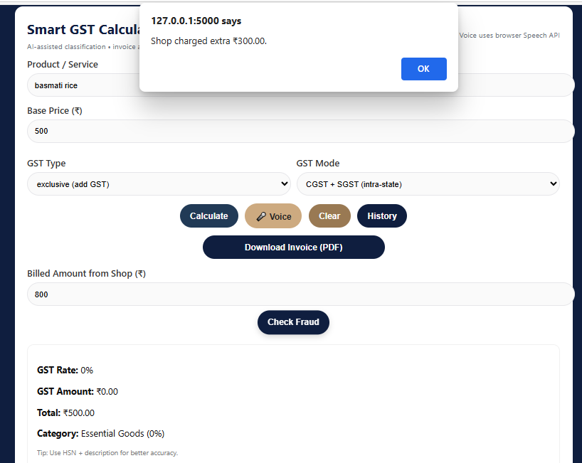
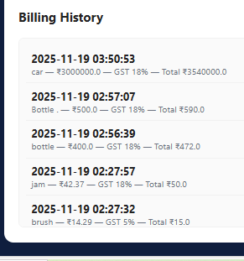
SMART GST – Intelligent GST Billing & Fraud
Detection System
History and Fraud Detection
.

Slide 15
Future Enhancements
SMART GST – Intelligent GST Billing & Fraud
Detection System
..
Add AI-based product classification using HSN codes for automatic GST slab selection.
Integrate real-time GST updates from government APIs.
Implement user accounts with cloud-based history storage.
Add multi-language voice input and chatbot support.
Launch a mobile app version for faster and offline access.

Slide 16
CONCLUSION
SMART GST – Intelligent GST Billing & Fraud
Detection System
SmartGST provides a fast, accurate, and user-friendly solution for GST calculation and fraud detection. With features like voice input, invoice generation, and billing history, it simplifies day-to-day billing for users. The system promotes transparency, reduces overcharging, and ensures reliable GST computation. Overall, SmartGST is an efficient tool designed to enhance user trust and simplify tax-related calculations.
THANK YOU !

